Slide 1

SliceNDice: Mining Suspicious Multi-attribute Entity Groups with Multi-view Graphs
Hamed Nilforoshan + Neil Shah
hn2284@columbia.edu nshah@snap.com
Snap Research
Notes:
Hi, my name is Hamed, I’m recent graduate from Columbia University
This is a presentation of my work during my internship at Snap Research, under Neil Shah
On how to use Multi-View Graphs to Detect Suspicious Multi-attribute Entity Groups

Slide 2
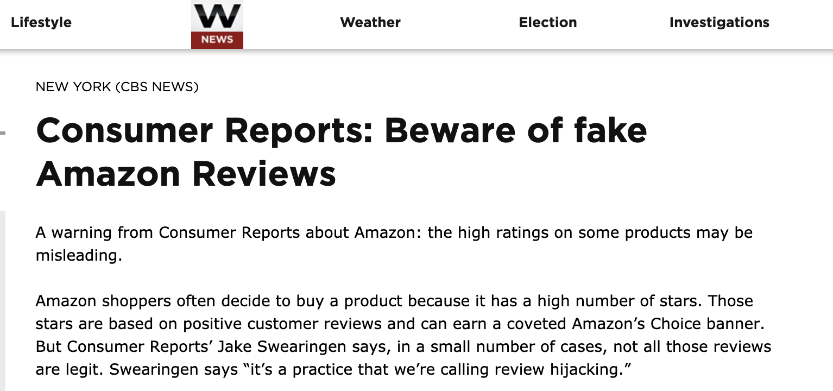


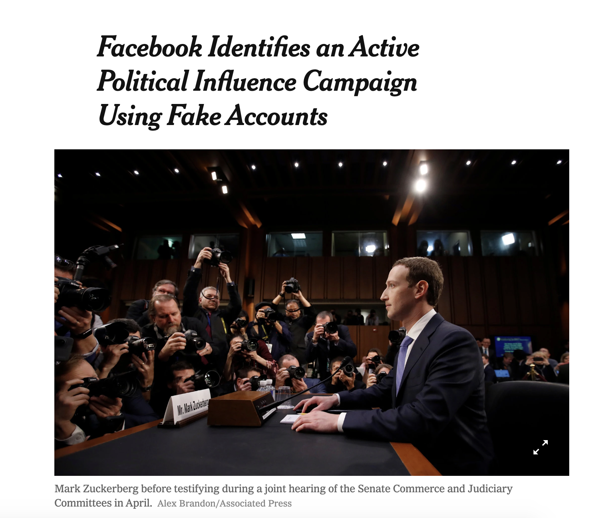
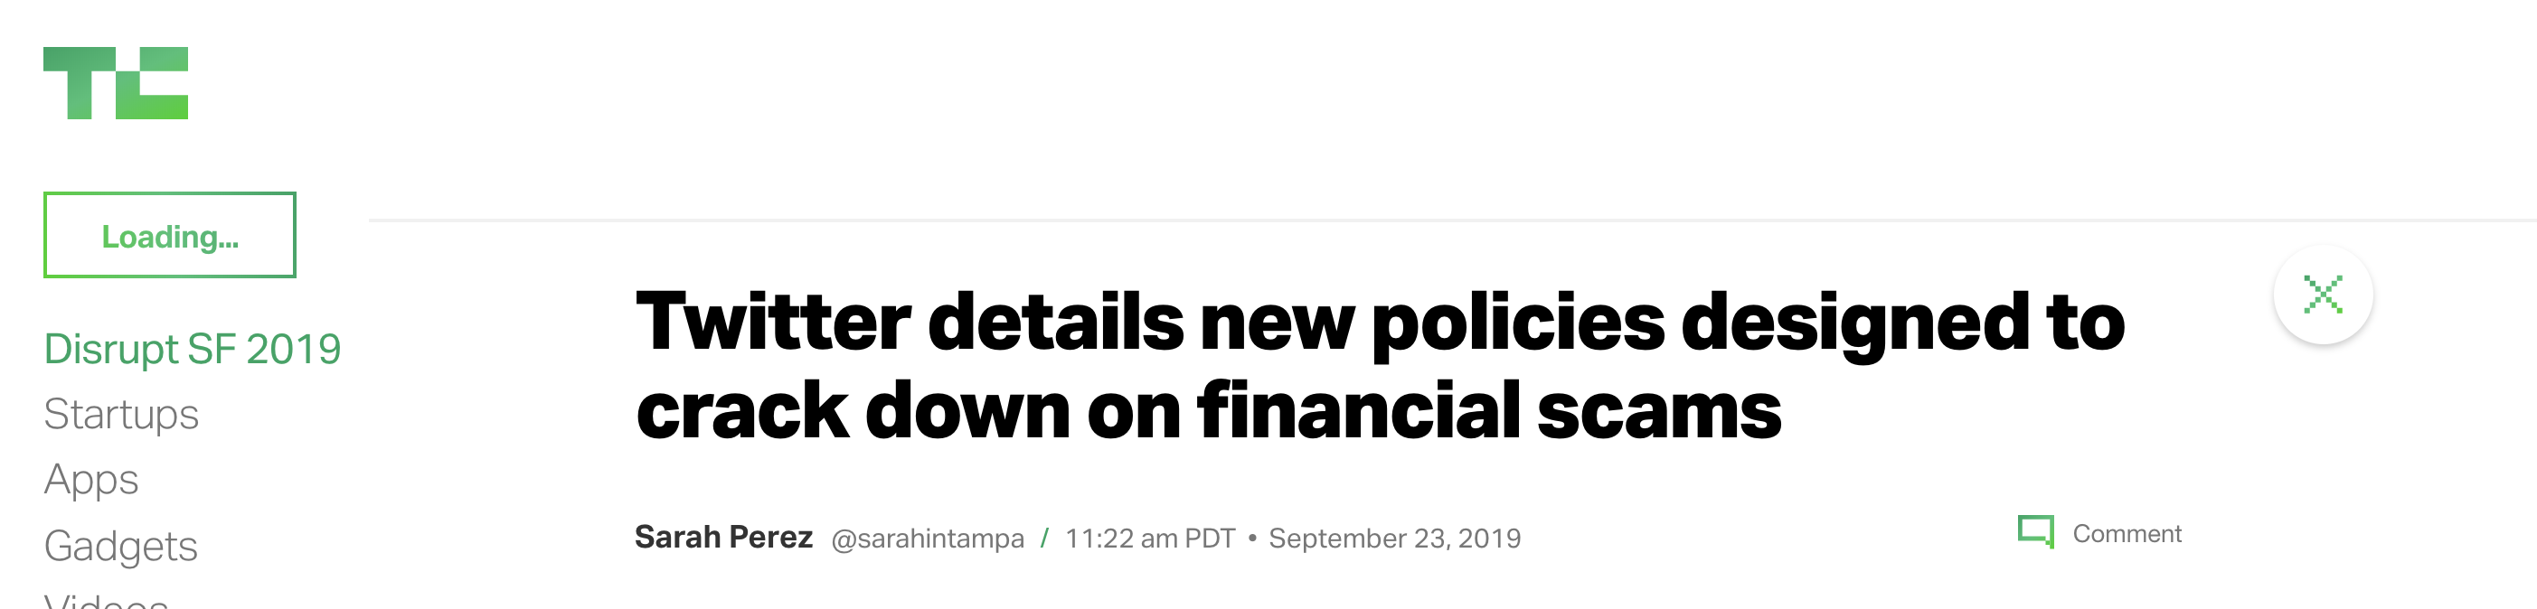
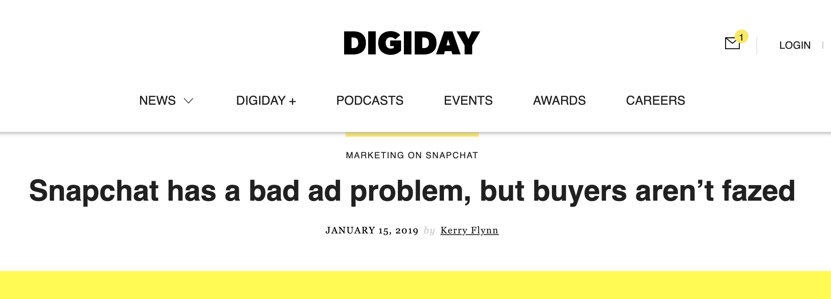
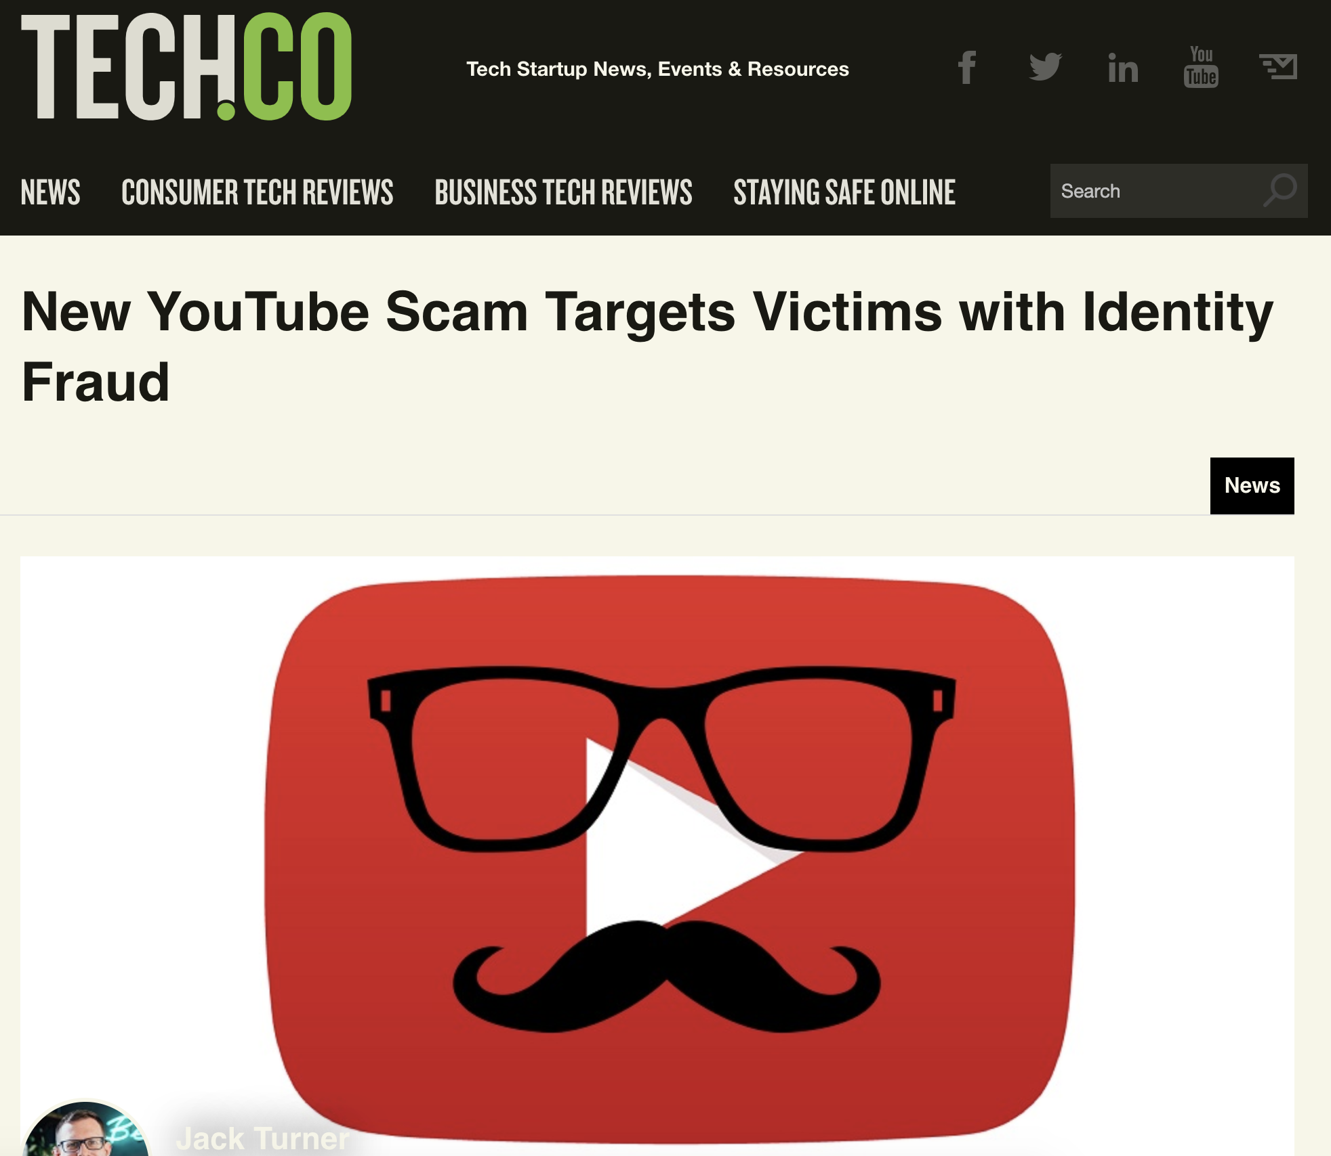
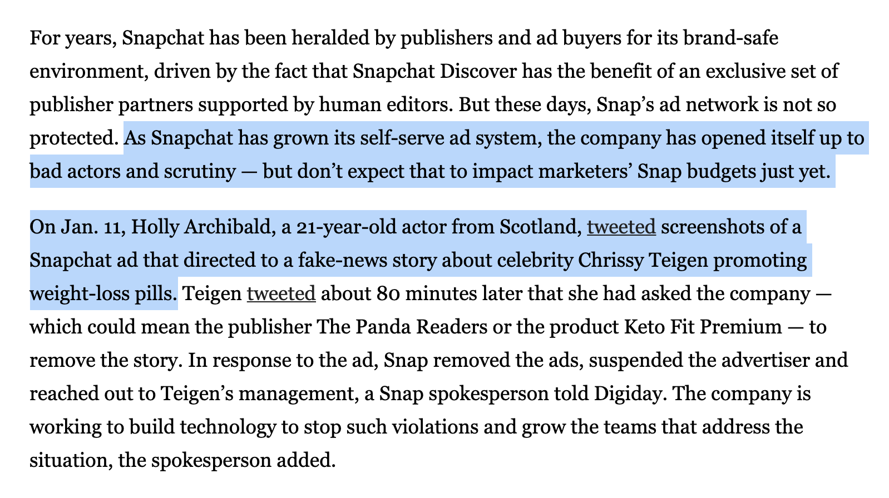
online fraud is everywhere
Notes:
If you’ve been reading the news lately, you can see that every major web platform deals with fraud
Online fraud, is everywhere

Slide 3

-$ billions
[1] https://www.consumer.ftc.gov/blog/2019/02/top-frauds-2018
Notes:
And this is a huge problem, because it costs both end users, and platforms losses on the order of billions of dollars
And just as important, fraud undermines the rule of law online, making internet use unsafe for end users

Slide 4
Challenges
Millions of users (requires scalability)
Limited ground-truth (suggests promise of unsupervised solutions)
Proactive discovery is hard (typically have to wait for user reports, chargebacks, etc.)
Feature-engineering is time-consuming, and domain-specific (domain-agnostic methods would be ideal)
Goal: scalable, unsupervised, multi-application, suspicious behavior detection

Slide 5
Key Insight
Fraudsters often behave with suspicious synchronicity
Organization
(e.g. CNN)
Key Idea: Model user entities as a graph, and uncover the most synchronous subgraphs as suspicious.
Same Campaign Name
Account
(e.g. CNN News, CNN Sports)
Similar pattern on many other web platforms (Facebook, Twitch, eBay, etc.)¹
[1] False Information on Web and Social Media: A Survey, Kumar and Shah 2018, CRC Press
Notes:
On Snapchat, advertisers use our platform by signing up as organizations
For example, CNN would sign up as an organization
And these orgs can control multiple accounts. For instance CNN might make accounts for its News and Sports sections.
We visualize a small subset of 7 real advertisers in this graph.
We tried drawing an edge between all users who shared the same campaign name
-----
And the really interesting thing is that we found this group of accounts which shared campaign names despite not
Being controlled by the same organization
We thought it was really suspicious that so many orgs would use the same campaign names in such a densely connected cluster
So we investigated these users and found that they were engaging in a coordinated fraud
----
Basically, these were all orgs controlled by A SINGLE person that was advertising an illegal product, and he kept on making news accounts in order to avoid getting caught.
----
On the other hand, we found that users that didn’t have any similarities, or only had similarities within a single organizations, were not engaging in any sort of fraud
----
Moreover, synchronicty indictating fraud isn’t just a snapchat phenomenon. Research shows that on MANY other web platforms--- Facebook, Twitch, Ebay, etcera
Synchronous user activity is a strong predictor of fraud
----
This is how we came up with the Key Idea behind our paper-----to model user entities as a graph, in order to uncover the most synchronous subgraphs as suspicious

Slide 6
Challenges
How do we…
…represent entity synchronicity as a graph? (Formulation)
…quantify the suspiciousness of a sub-graph? (Scoring)
…find highly suspicious sub-graphs? (Discovery)

Slide 7
Our Contributions
Problem Formulation
Model multi-attribute entity data as a multi-view graph

Slide 8
Problem Formulation (High-level)
Input: Entities and associated attributes
Entity a, attribute i = set of values
Multi-View Graph
ID | IPs | URL Hash | Assets
0 | {1.2.3.4} | {b1c45} | {Cheap-Iphone.jpg}
1 | {103.71.11.5} | {ytnw71} | {Smoothie.jpg}
2 | {201.27.18.6} | {1m572d} | {main.jpg}
3 | {112.11,16.1, 1.2.3.4} | {a6wu7} | {Promotion-1.jpg, Cheap-Iphone.jpg}
4 | {1.2.3.4} | {a6wu7, b1c45} | {Cheap-Rolex.jpg}
0
0
0
1
4
1
4
1
4
2
3
2
3
2
3
IPs
URL Hash
Assets
Entity → Node, Shared Attribute Value → Edge
Output: highly synchronous sub-graphs and views
Notes:
At a high level, in any web platform, you are going to have a database of entities (e.g. user accounts)
These entities will have different metadata associated with them, in the form of attributes.
For example, here is an anonymized subset of our Snapchat advertisers dataset
Each row signifies an entity, and each column is an attribute. The three attributes are IP address, URL hash, which is the URL that a user linked their add to, and a list of file uploads
----
Now, the way that we formulate this as a graph mining problem is by representing each entity as a node, and each shared value between enttiies as an edge between the nodes.
For instance, Users 3 and 0 share the Same IP address in this table, and so they have an edge between them
What is novel with our formulation is that we represent these attributes as a Multiview graph, where each view is unique cut showing similarities ina specific attribute
It’s critical to separate out attributes into different views because different attributes might have different meanings. For instance, IP address might be a strong signal for fraud, but Assets might not because a lot of people use the same stock images in their adds. By separating attributes into views, we can put different amounts of weight on different features depending on their contextual significance
----
Now, after transforming this table into a multi-view graph, comes the critical challenge…. How do we find the mostly highly synchronous sub-graph, and the views in which it is the most synchronous.

Slide 9
What is “suspiciousness”?
Intuition: lots of edges across many nodes = bad
Most ordinary users not likely to share metadata
Pesky details: How to handle multiple views? What’s more suspicious?
2 entities sharing IP, or 5 entities sharing zip code?
View 1: IP Addresses
View 2: Zip code
Notes:
This brings us to the main, philosophical question of our Paper, which is… what is suspiciousness…

Slide 10
Our Contributions
Problem Formulation
Model multi-attribute entity data as a multi-view graph
Defining Suspiciousness
5 intuitive axioms
1 suspiciousness metric which satisfies all of them

Slide 11
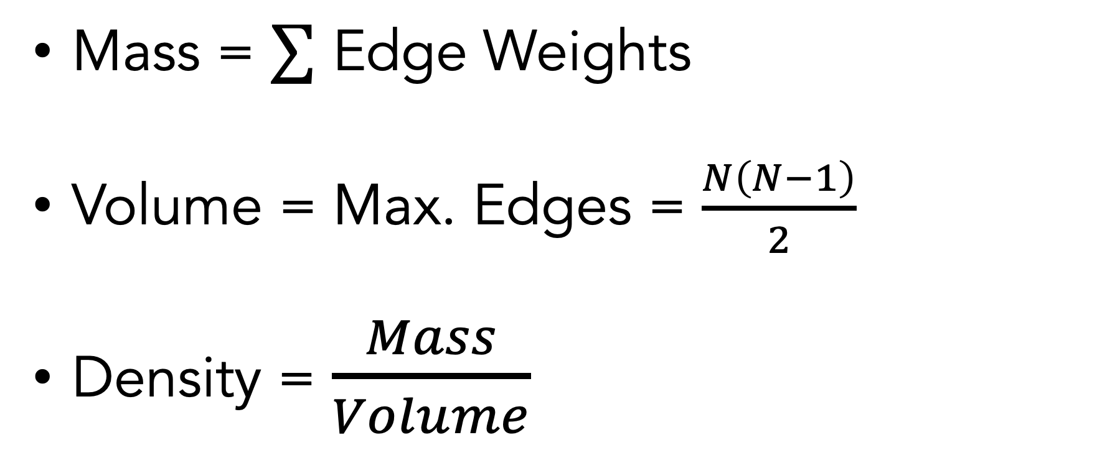
Sub-graph Properties
Mass = $∑$ Edge Weights
Volume = Max. Edges = $\frac{N\left(N−1\right)}{2}$
Density = $\frac{Mass}{Volume}$

Slide 12
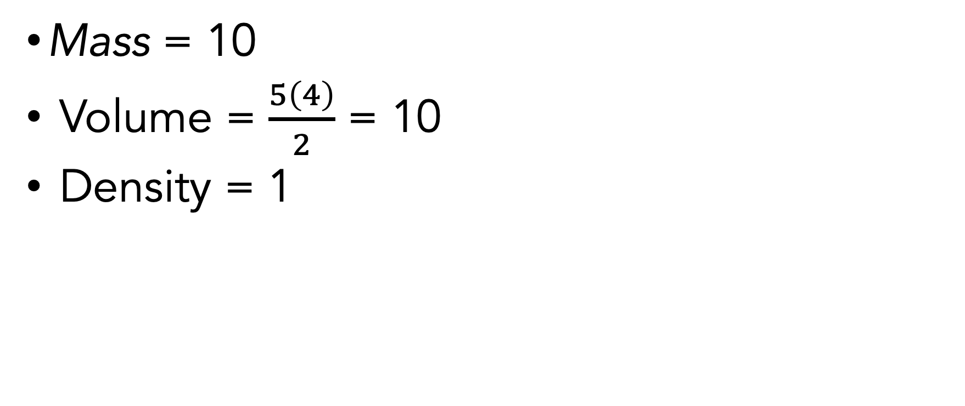
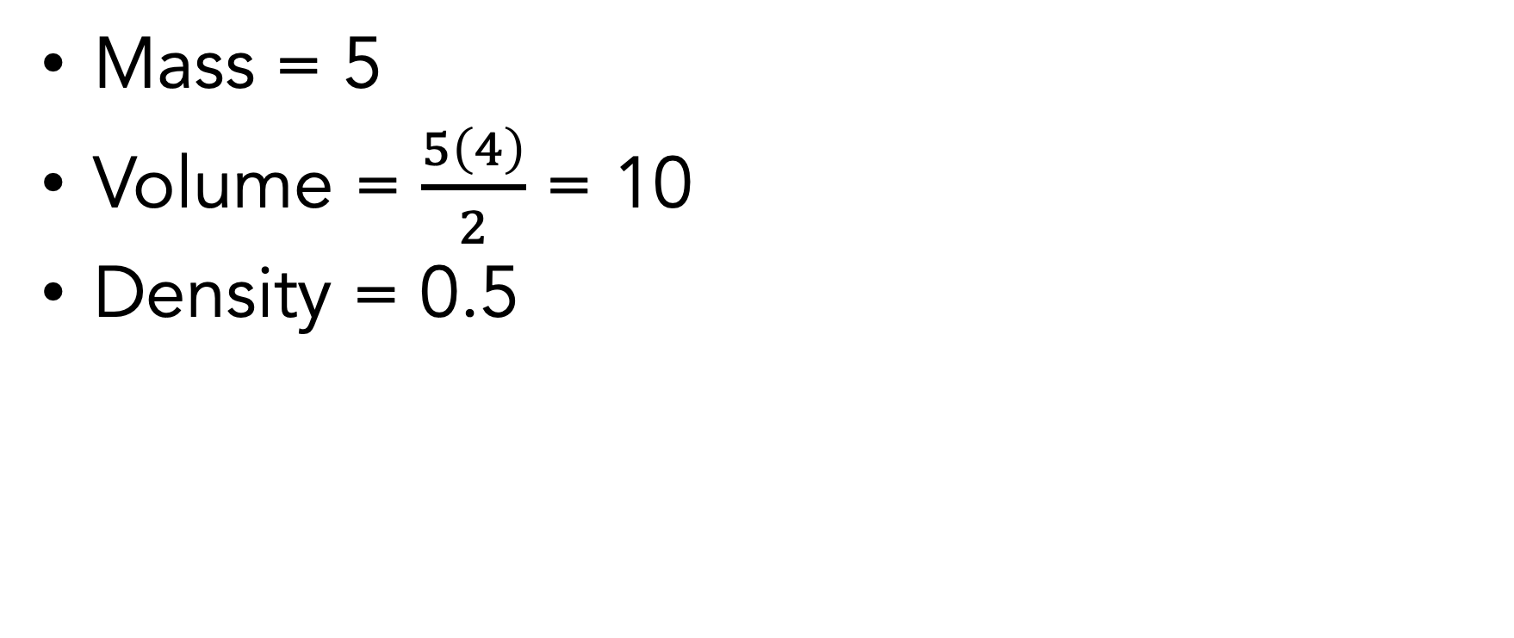
Sub-graph Properties
Mass = 10
Volume = $\frac{5\left(4\right)}{2}$ = 10
Density = 1
Mass = 5
Volume = $\frac{5\left(4\right)}{2}$ = 10
Density = 0.5

Slide 13
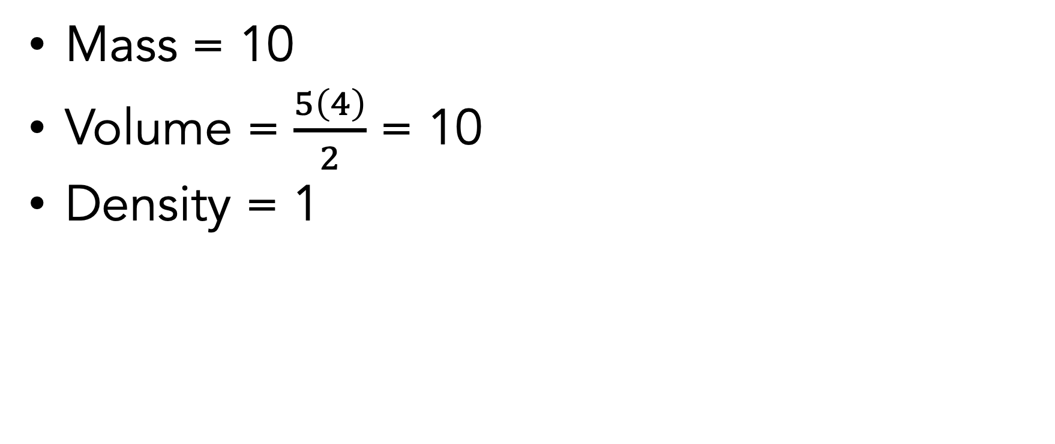
Sub-graph Properties
Mass = 10
Volume = $\frac{5\left(4\right)}{2}$ = 10
Density = 1
Notes:
So naturally, you might ask, can we just use mass as a measure of suspiciousness?
And the answer is that mass sometimes works, but it often doesn’t.
For example consider returning tot his graph, it has a mass of 10.
But this graph also has a mass of 10, even though it has almost twice as many nodes.
Intuitively. This group is a lot more suspiiocus because it is saturated with edges,
Whereas as nodes in this group only share a few edges with a few others in the group.
----
Thus, we cannot take just mass, volume, or density into account--- we need to think holistically about all 3 of them.

Slide 14
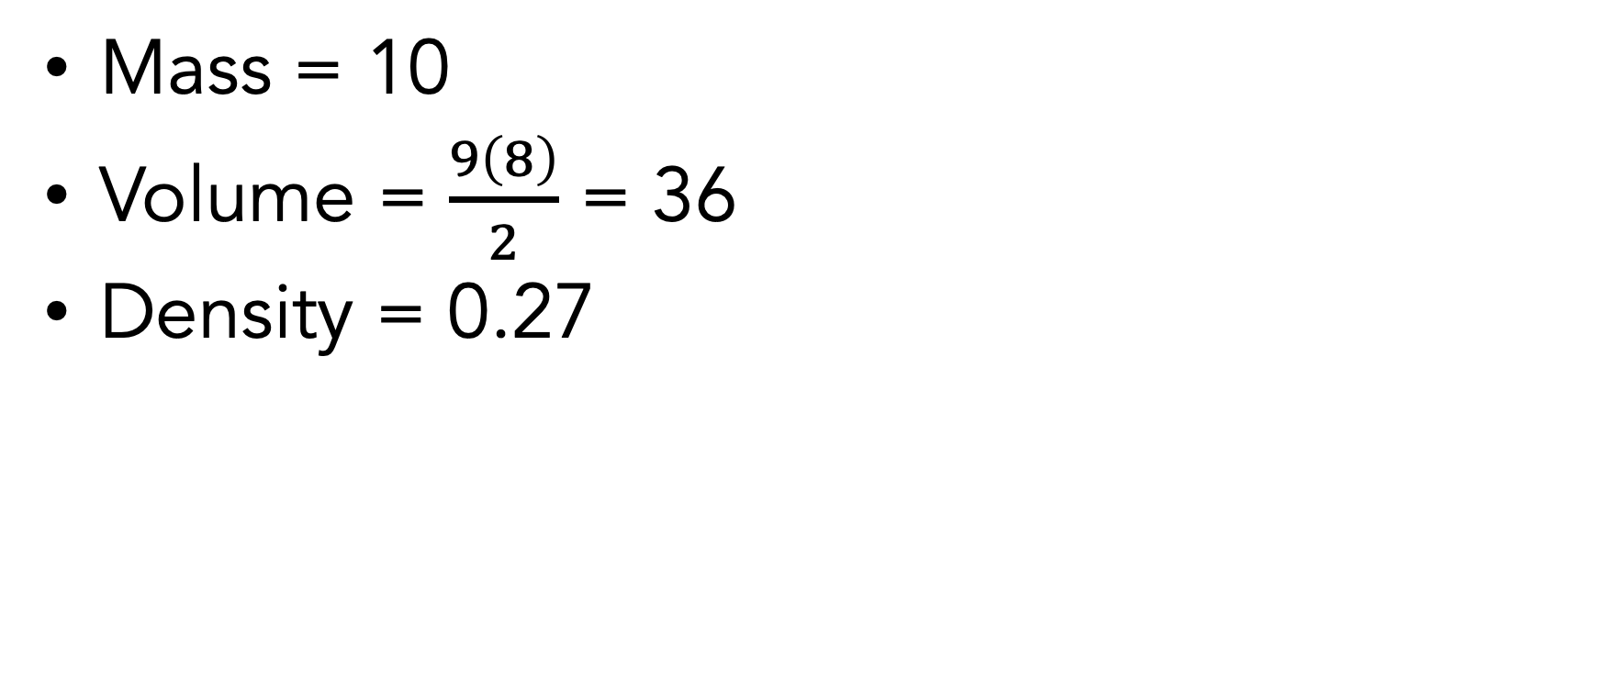
Sub-graph Properties
Mass = 10
Volume = $\frac{9\left(8\right)}{2}$ = 36
Density = 0.27
Notes:
So naturally, you might ask, can we just use mass as a measure of suspiciousness?
And the answer is that mass sometimes works, but it often doesn’t.
For example consider returning tot his graph, it has a mass of 10.
But this graph also has a mass of 10, even though it has almost twice as many nodes.
Intuitively. This group is a lot more suspiiocus because it is saturated with edges,
Whereas as nodes in this group only share a few edges with a few others in the group.
----
Thus, we cannot take just mass, volume, or density into account--- we need to think holistically about all 3 of them.

Slide 15
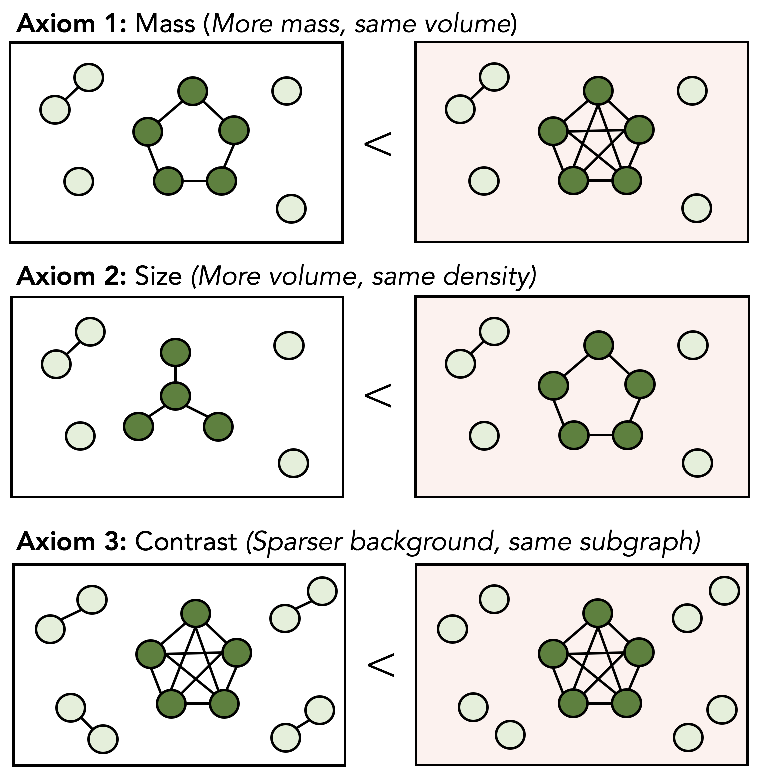
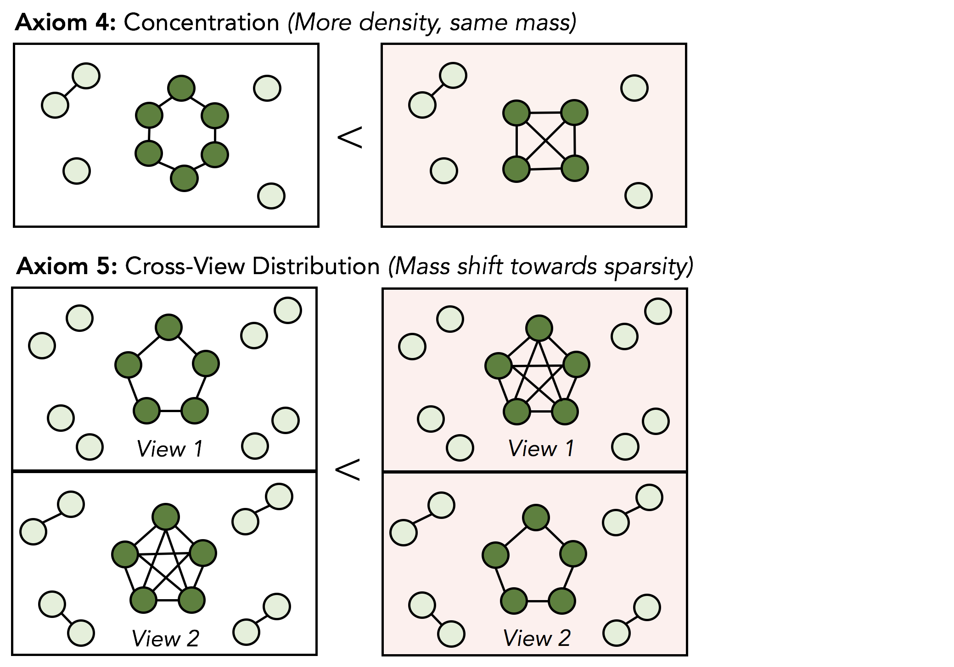
Axioms
What should a good suspiciousness metric prioritize?

Slide 16
Axiom 1: Mass (more mass, same volume)
More similarities = more suspicious

Slide 17
Axiom 2: Size (more volume, same density)
Larger fraud rings = higher priority

Slide 18
Axiom 3: Contrast (sparser background, same subgraph)
Less background noise = more suspicious
(e.g. 5 users with same zipcode < 5 users with same IP address)

Slide 19
Axiom 4: Concentration (More density, same mass)
(e.g. 10 shared IPs between 100 users <
10 shared IPs between 10 users)

Slide 20
Axiom 5: Cross-view distribution (Mass shift toward sparsity)
View 1
IP Address
IP Address
View 2
Zipcode
Zipcode
(e.g. 100 users, 10 shared IP, 90 shared zipcodes <
100 users, 90 shared IP, 10 shared zipcodes)
Notes:
This axiom is really important to understand because it has to do with the relationships
Between views.
Lets say you have two subgraphs which the total mass. But this one has more of its mass in the first view, and this one

Slide 21
Axioms
Goal: metric to satisfy all 5/5 axioms
Metrics from prior work satisfy, at best, 3/5

Slide 22
Additional Criteria
Metric should support continuous edge weights
{ Toledo, OH,
New York, NY}
{ Toledo, OH}
{ New York, NY}
1
2
1
2
1
2
{ New York, NY}
{ Toledo, OH}
{ Toledo, OH,
New York, NY}
Weight by rarity and number of distinct shared values
Use TF-IDF score (where Entity ~ Document)
Notes:
Additionally, there is 1 more constraint which is that our metric needs to handle continuous edge weights
The reason for this is that not all edges are the same.
For instance, if two accounts share the same city because they are both from New York, that is barely suspicious
But, if they both share come from a rare city like Toledo, Ohio, that is a lot more suspicious
And even more suspiiocus would be if both accounts had logged into both citiies
Thus, we want to weight edges by two things: Rarity, meaning how surprising a given value is, and Number of shared values
To do this we use an NLP concept which is TF-IDF, which takes into account how frequent each value is across our whole dataset

Slide 23
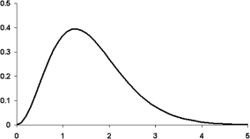
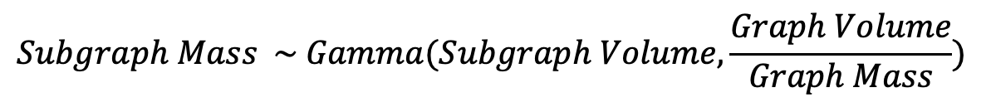
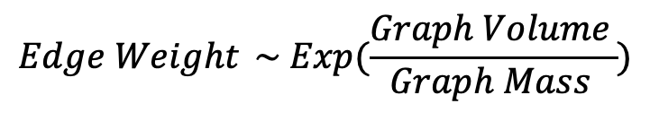
SliceNDice Metric (Single View)
Erdos-Renyi-Exponential model
$${Edge Weight}_{ } \sim Exp(\frac{Graph Volume_{ }}{Graph Mass_{ }})$$
(Expected value is average edge weight)
$$Subgraph Mass \sim Gamma(Subgraph Volume,\frac{Graph Volume}{Graph Mass})$$
Satisfies all 5/5 axioms!!!
1
2
-log( )
likelihood
3
4
Subgraph Mass
Notes:
Ok, great, now the moment you have all been anxiously waiting for….
How do we define our suspicious metric?
Our method is actually relatively simple. We start from the Erdos-Renyi-Exponential model, which assumes that all edge weights follow an exponential distribution with this parameter.
We choose this model because the edge weights in our data do closely follow an exponential distribution.
And The reason we choose this parameter is that it sets the expected value of the edge weights to be equal to the average edge weight in our actual observed graph data.
Secondly, we prove in our paper that if we use this model, then the subgraph mass will follow a gamma distribution with these 2 parameters: The subgraph volume, and the overall graph volume over the mass. I can’t explain why this follows due to time, but the proof is in our paper.
Now, modeling the subgraph mass as a gamma distribution gives us a very useful probability distribution over different possible masses for a subgraph. And intuitively, as the masses get higher and higher, the probability goes down.
For example, at a mass of 0, this probability is the highest.. But as we keep adding edges to this graph, the probability continuously goes down. Now this is really important, because the whole idea for our paper is to detect anomalously high amounts of mass, and this disrirbution gives us a way to quantify how anomalous the graph of a mass is.
By taking the –log of likelihood

Slide 24
SliceNDice Metric (Single View)
Erdos-Renyi-Exponential model
$${Edge Weight}_{ } \sim Exp(\frac{Graph Volume_{ }}{Graph Mass_{ }})$$
(Expected value is average edge weight)
$$Subgraph Mass \sim Gamma(Subgraph Volume,\frac{Graph Volume}{Graph Mass})$$
Satisfies all 5/5 axioms!!!
5
1
2
likelihood
Suspiciousness
-log(Subgraph Mass Likelihood)
3
4
0
Subgraph Mass
Notes:
we are able to generate a suspiciousness score that increases monotonically with subgraph mass.

Slide 25
SliceNDice Metric (Single View)
Erdos-Renyi-Exponential model
$${Edge Weight}_{ } \sim Exp(\frac{Graph Volume_{ }}{Graph Mass_{ }})$$
(Expected value is average edge weight)
$$Subgraph Mass \sim Gamma(Subgraph Volume,\frac{Graph Volume}{Graph Mass})$$
Satisfies all 5/5 axioms!!!
5
1
2
likelihood
Suspiciousness
-log(Subgraph Mass Likelihood)
3
4
0
Subgraph Mass
Notes:
So as we get more an more mass, the suspiciousness goes up and up.

Slide 26
SliceNDice Metric (Single View)
Erdos-Renyi-Exponential model
$${Edge Weight}_{ } \sim Exp(\frac{Graph Volume_{ }}{Graph Mass_{ }})$$
(Expected value is average edge weight)
$$Subgraph Mass \sim Gamma(Subgraph Volume,\frac{Graph Volume}{Graph Mass})$$
Satisfies all 5/5 axioms!!!
5
1
2
likelihood
Suspiciousness
-log(Subgraph Mass Likelihood)
3
4
0
5
Subgraph Mass
Notes:
Furthermore, the benefit fo this metric is also responsive to volume. For instance if we add a node to the graph, the mass will stay the same, but the volume in this parameter goes up. As a result, the distribution actually shifts downward, decreasing the suspiciousness.

Slide 27
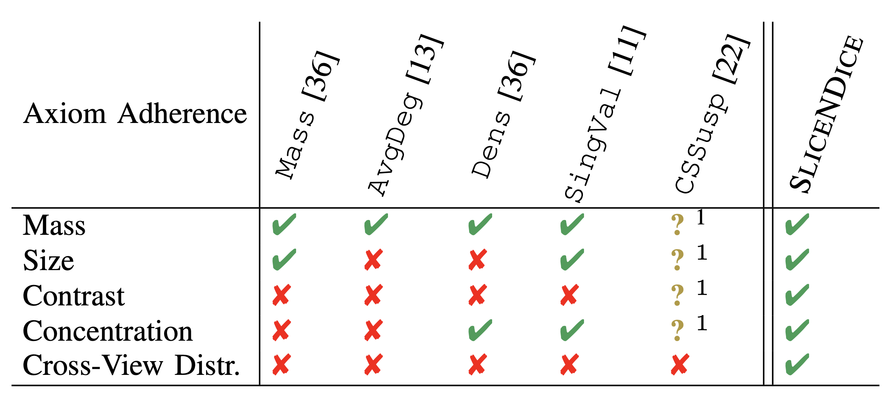
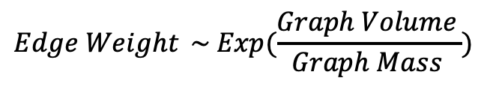
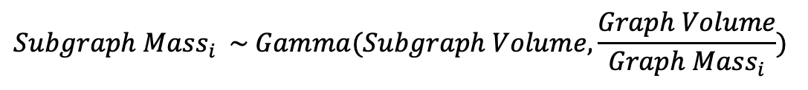
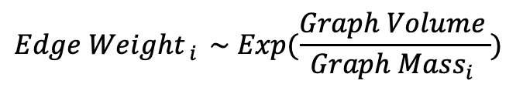
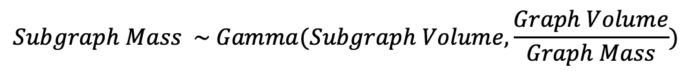
SliceNDice Metric (Multi-View)
Satisfies all 5/5 axioms!
$${Edge Weight}_{ } \sim Exp(\frac{Graph Volume_{ }}{Graph Mass_{ }})$$
$$Subgraph Mass \sim Gamma(Subgraph Volume,\frac{Graph Volume}{Graph Mass})$$
Suspiciousness = -log(Subgraph Mass Likelihood)
Multi-View Version:
$${Edge Weight}_{ i } \sim Exp(\frac{Graph Volume_{ }}{Graph Mass_{i }})$$
$$Subgraph Mass_{i} \sim Gamma(Subgraph Volume,\frac{Graph Volume}{Graph Mass_{i}})$$
Model mass of each view independently
Suspiciousness = -log(Overall Subgraph Mass Likelihood) =
-log(Subgraph Mass Likelihood_{view 1} x Subgraph Mass Likelihood_{View 2} … Subgraph Mass Likelihood_{View n})
Notes:
Now there is one final step, which is to generalize this to the multi-view case.
To recap, we assumed that edge weights follow an exponential distribution, which allows us to model the probability of observing a subgraph mass, and we defined suspiciousness as the negative log likelihood of observing a particular mass.
---
To generalize this to the multi-view setting all, we do is model the edge weights in each view independently. So for instance EdgeWeight_i is the edge weight distribution for view i.
We then adapt our metric as well, by defining susp as –log likelihood of the overall mass. Because they are independent, this is just the mass likelihood of each of the views multipled by each other.
---
Finally, we e in our paper that because this metric is sensitive to mass, volume, and density…. It satisfies all of our axioms.
We also compare it to metrics from prior work and show where other metrics break down.

Slide 28

Challenges
How do we…
…represent entity synchronicity as a graph? (Formulation)
…quantify the suspiciousness of a sub-graph? (Scoring)
…find highly suspicious sub-graphs? (Discovery)
Trillions of possible sub-graphs, infeasible to score all of them

Slide 29
Our Contributions
Problem Formulation
Model multi-attribute entity data as a multi-view graph
Defining Suspiciousness
5 intuitive axioms
1 suspiciousness metric which satisfies all of them
SliceNDice Algorithm
Local alternating maximization strategy

Slide 30
SliceNDice Algorithm
Local alternating maximization strategy to find single suspicious group
Start with a small, random “seed” subgraph
Repeat until metric converges
a. Add/remove single node to maximize metric
b. Revise view set to maximize metric
Repeat with to find more sub-graphs (can also parallelize)
Rank sub-graphs by metric

Slide 31
SliceNDice Algorithm
1. Start with small, random “seed”
0
0
0
(e.g. 2 nodes, 2 views)
1
4
1
4
1
4
2. Repeat Until Metric Converges
2
3
2
3
2
3
a. Add/remove a node
IPs
URL Hash
Assets
b. Revise views
Suspiciousness
Iteration
1a 1b 2a 2b 3a 3b
Notes:
Let me show an example

Slide 32
SliceNDice Algorithm
How to choose good seeds?
See paper, ”GreedySeed” efficient seeding technique
How to pick best node / views at each iteration?
See paper, optimizations reduce metric computation from O(n²) → O(n)
Try all possibilities, pick locally optimal
Notes:
This brings us to our main contribution, which is the idea to leverage these existing models to provide writing feedback
practical example hwo we compute metric

Slide 33
Evaluation
Notes:
This brings us to our main contribution, which is the idea to leverage these existing models to provide writing feedback
practical example hwo we compute metric

Slide 34
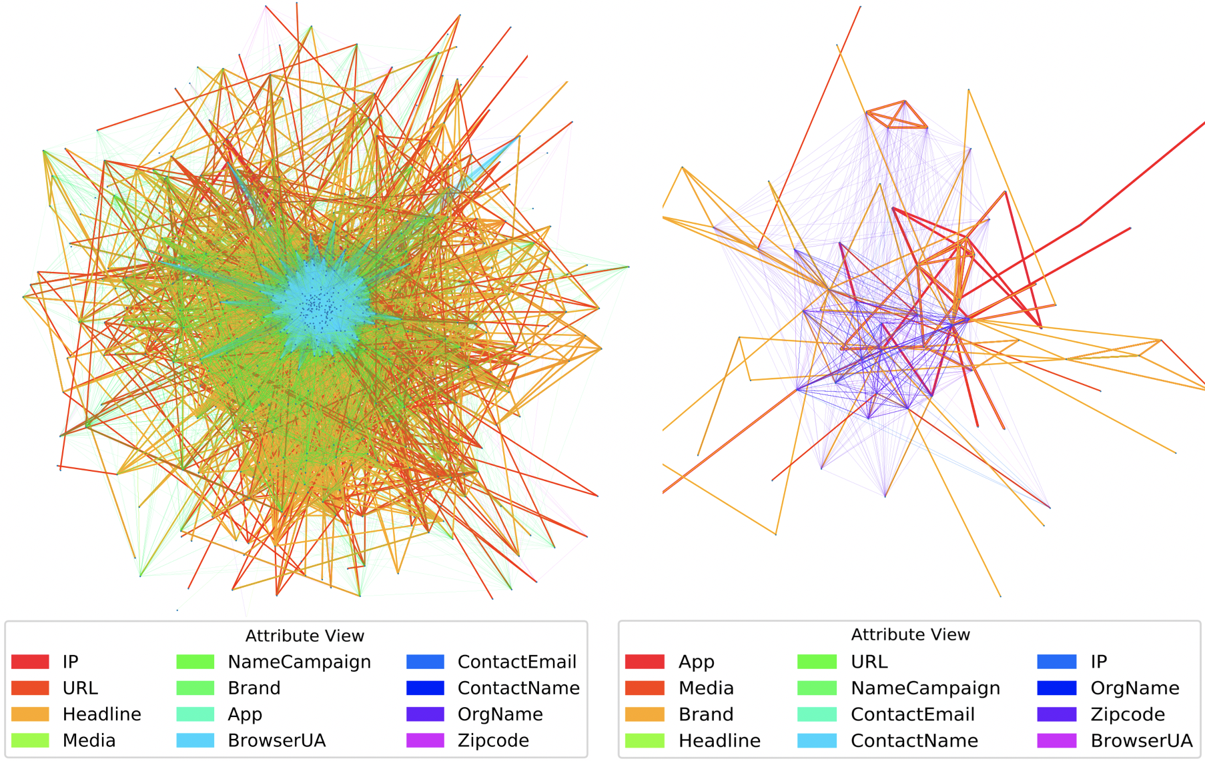
Case study: advertiser fraud
89% precision over Snap ad accounts from top-50 most suspicious rings
“blatant” e-commerce fraud
“stealthy” app-promotion fraud

Slide 35
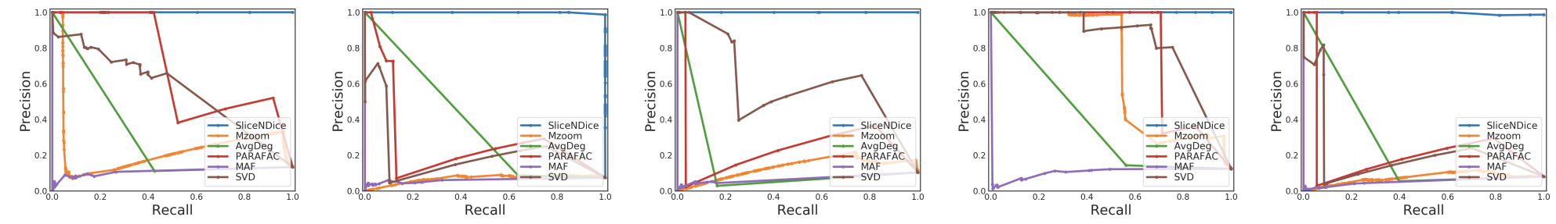
Results
Better than state-of-the-art performance on a variety of simulated attack settings.
Compared with
Mzoom (Shin et al., 2016)
PARAFRAC (Mao et al, 2014)
AvgDeg (Charikar et al., 2000)
MAF (Maruhashi et al., 2011)
SVD (Parakash et al., 2010)
Prior work doesn’t adhere to all 5/5 axioms
Performance degrades in multi-view settings
Notes:
List of all other dense sub-graph mining methods we could use
We compared against all of them and found much stronger performance in synethetic evals
Reason being they don’t support all 5 axioms, so they don’t do well with multi-view data

Slide 36
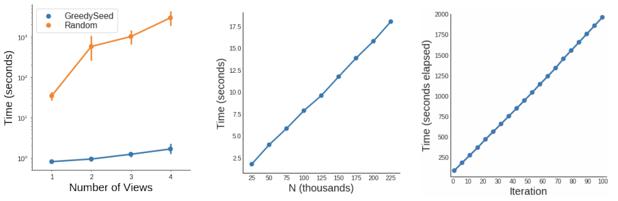
Results
Fast and efficient: Runtime linear in # of advertisers and group size. Constant space complexity. Efficient seeding strategy.
Notes:
List of all other dense sub-graph mining methods we could use
We compared against all of them and found much stronger performance in synethetic evals
Reason being they don’t support all 5 axioms, so they don’t do well with multi-view data

Slide 37
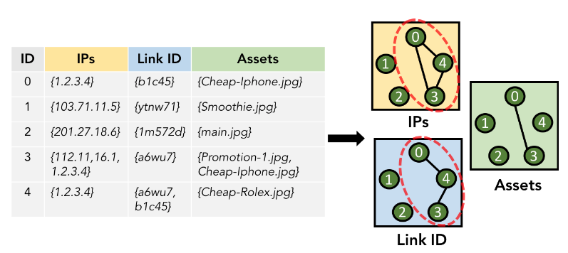
Generality
The approach here works for a class of problems, in which we have “entities” and associated attribute values.
Another use-case: discovering malicious user account clusters

Slide 38
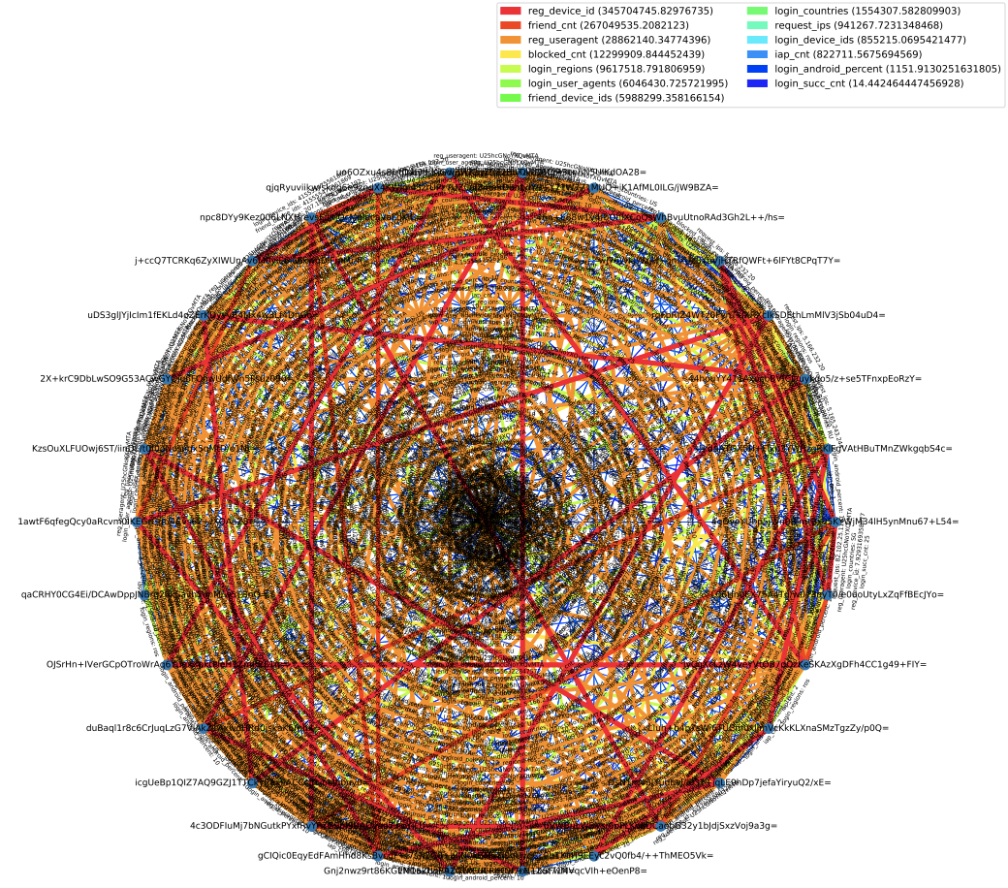
Friending spam and registration botnet

Slide 39
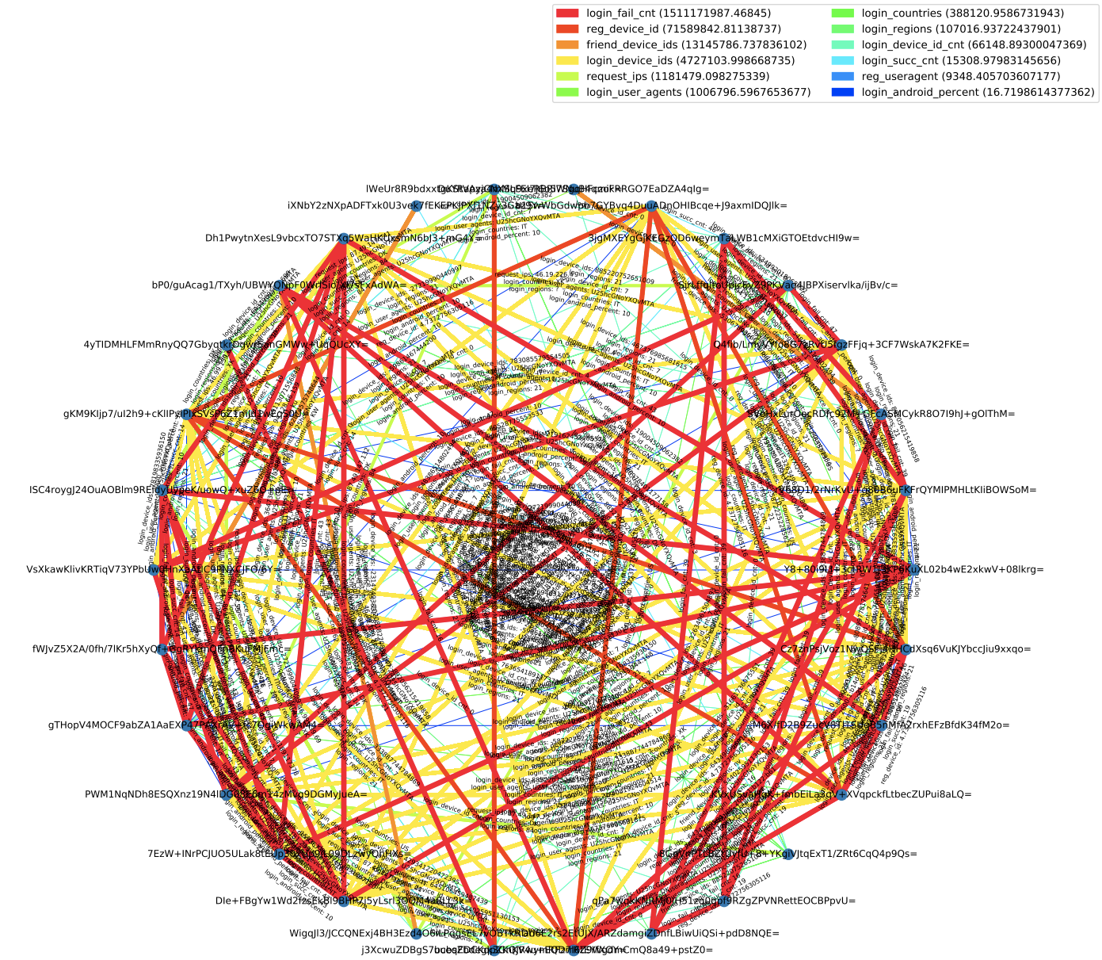
Account farm, login and friending device reuse

Slide 40
Conclusion
Multi-attribute entity data → Multi-view graphs
General-purpose, interpretable, method to catch fraud
Thank you!
Hamed Nilforoshan
hamedn.com
Notes:
The main difference is that our approach respects the difference between attributes.
Other approaches would flatten everything into one graph and lose the context what an edge means, depending on what attribute it came from
So for example they would see a similarity between IP address and zipcode as the same thing
But we use multi-view graphs so our metric is able distinguish what is anomalous in the context of each view
----
So at a high level these works follow a similar structure, the difference is our goal is supsiopcusnes and so our axioms and intuitions are different

Slide 41
Thank you!
Hamed Nilforoshan
hamedn.com
Notes:
Finally, to summarize our work.
Our paper describes an automated approach to generate social media writing feedback.
Our main idea is to leverage existing quality prediction models with a combination of perturbation analysis, and segmentation.
* How to run the algorithm
* What does algorithm look like

